Slide 1
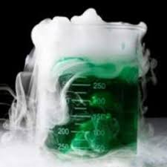
Lecture 12:
reactions!

Slide 2

Reactions of alkenes
Reaction mechanisms

Slide 3
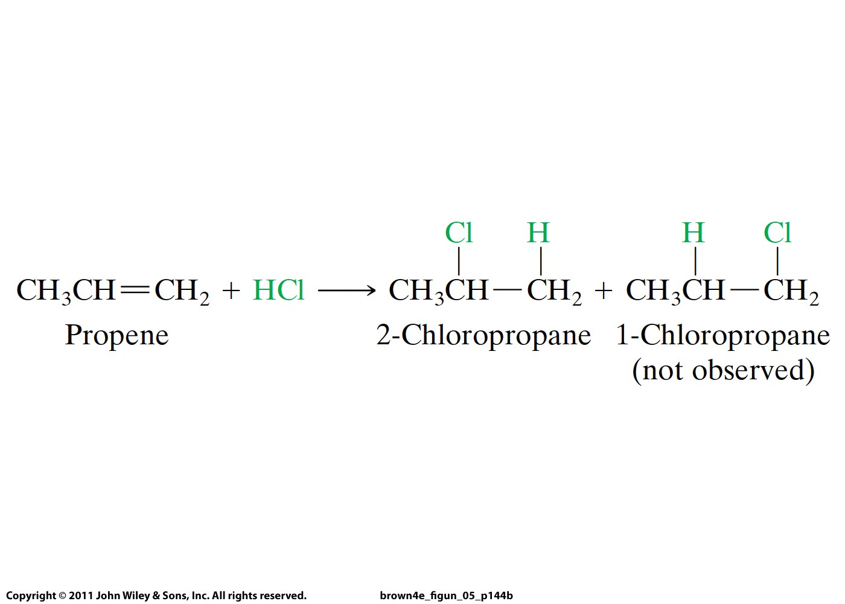
Reaction mechanism:
Step-by-step description on how a reaction occurs
Above knowledge allows one to predict reactivity.
For example, it allows one to tell which of below
products are formed in this reaction:

Slide 4
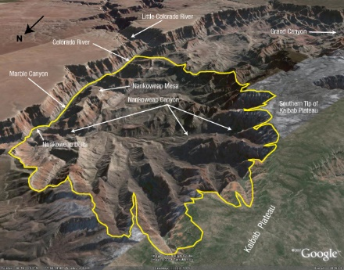

Slide 5
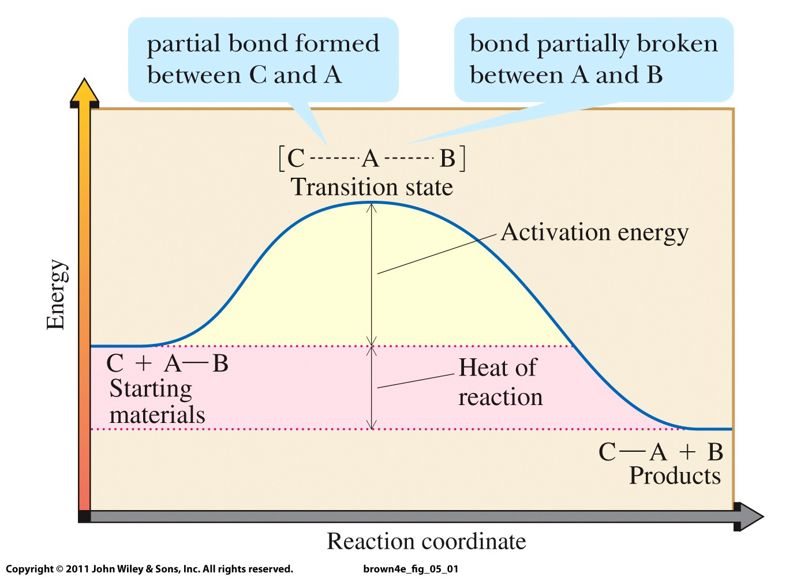

Slide 6
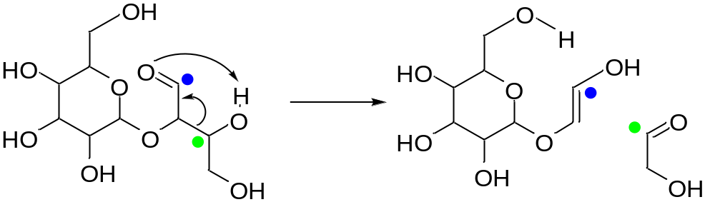
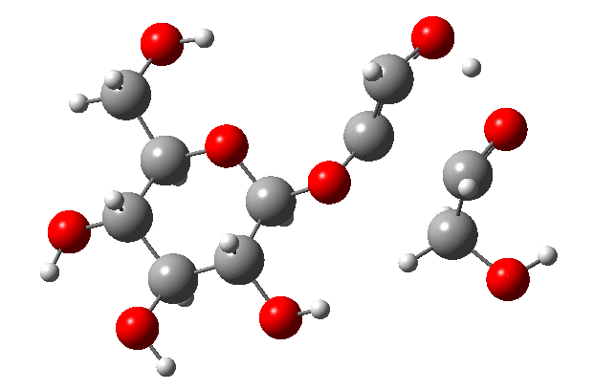

Slide 7
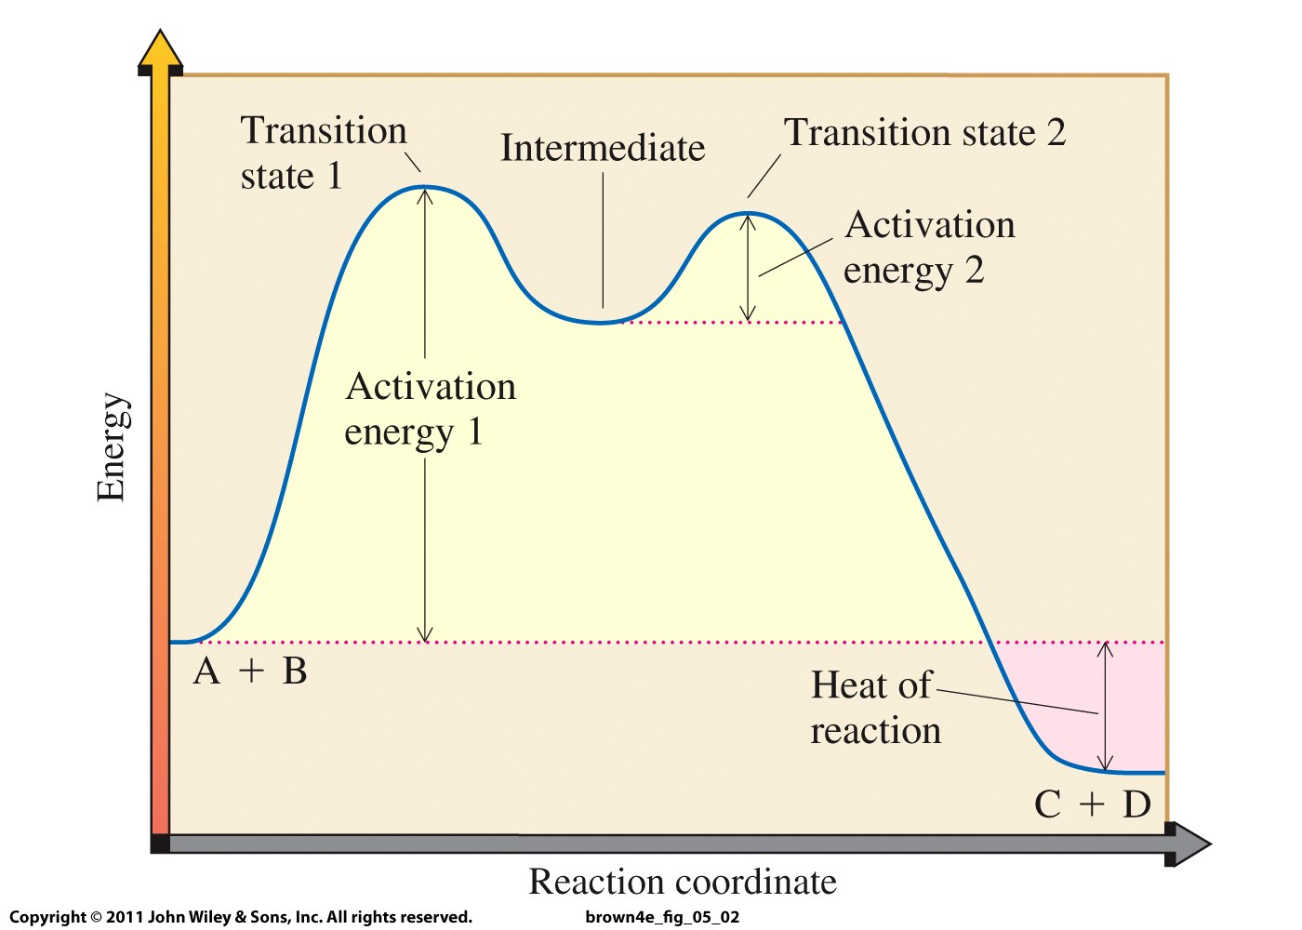

Slide 8
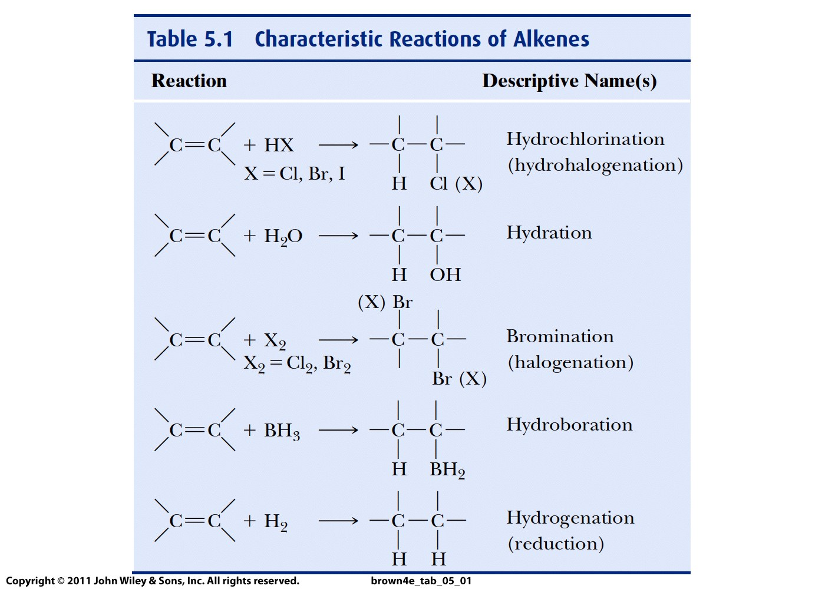

Slide 9
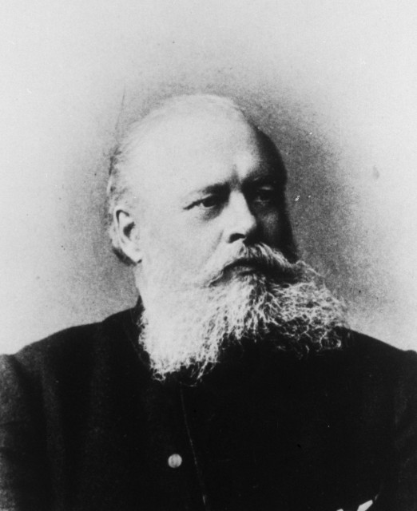
Vladimir Vasilyevich
Markovnikov
(Russia)
1837-1904

Slide 10
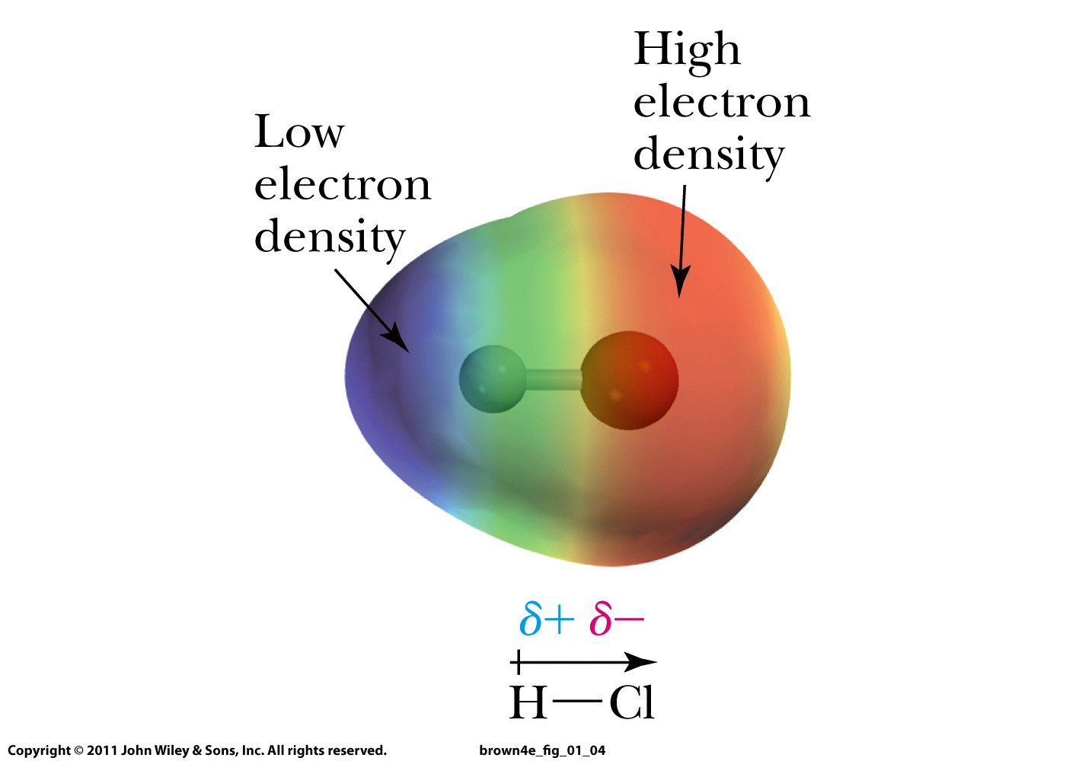

Slide 11
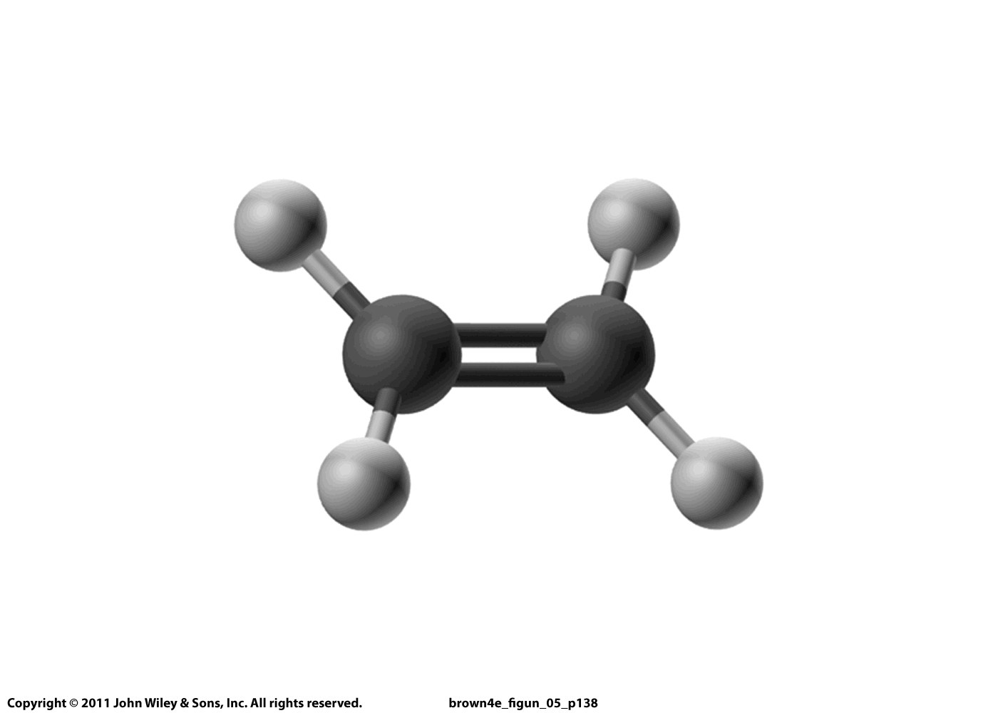
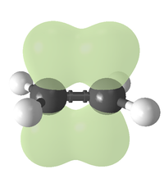

Slide 12
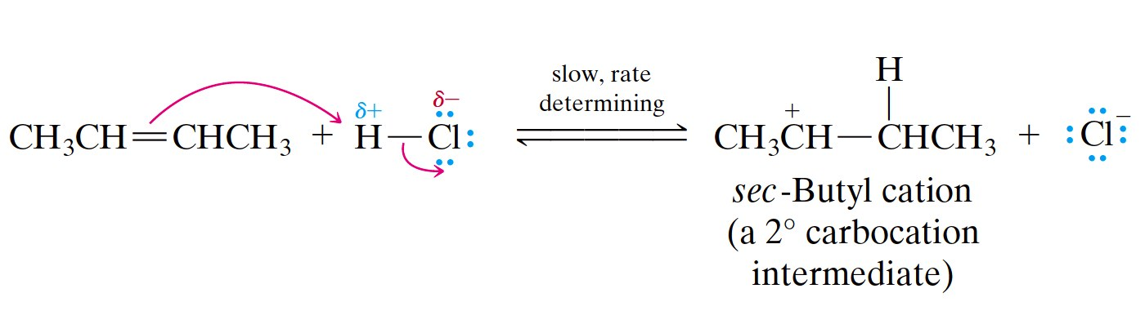
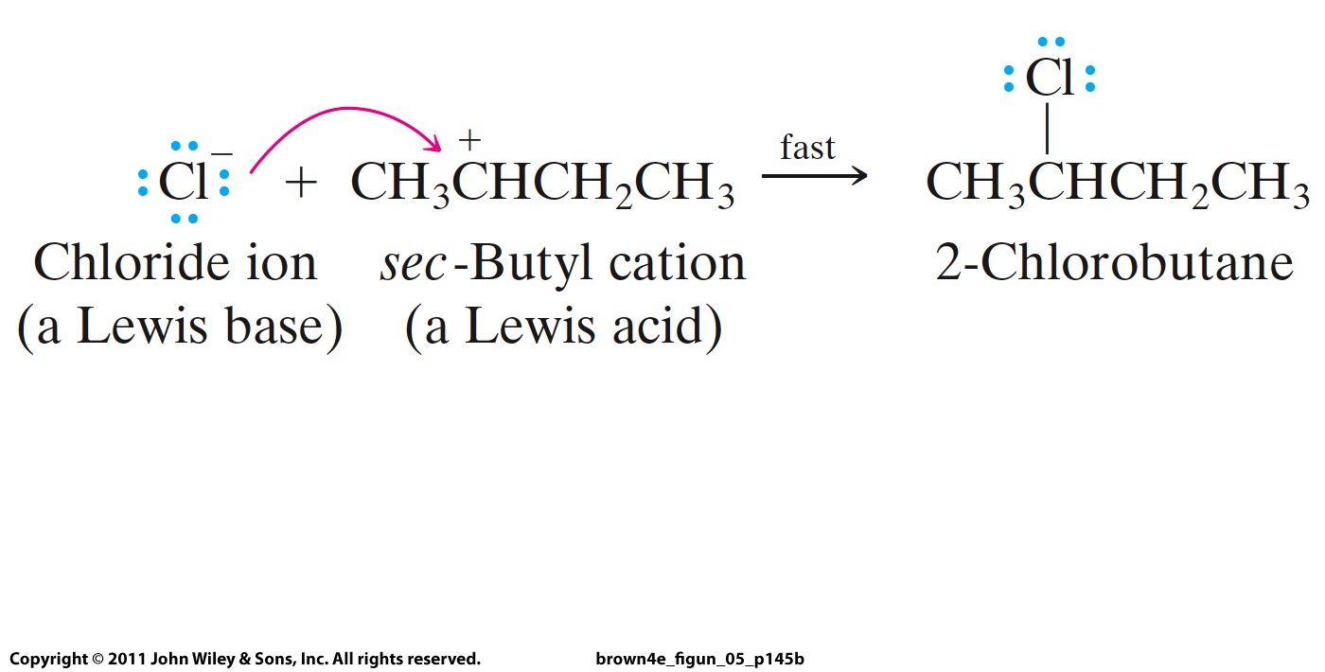
nucleophile
electrophile

Slide 13
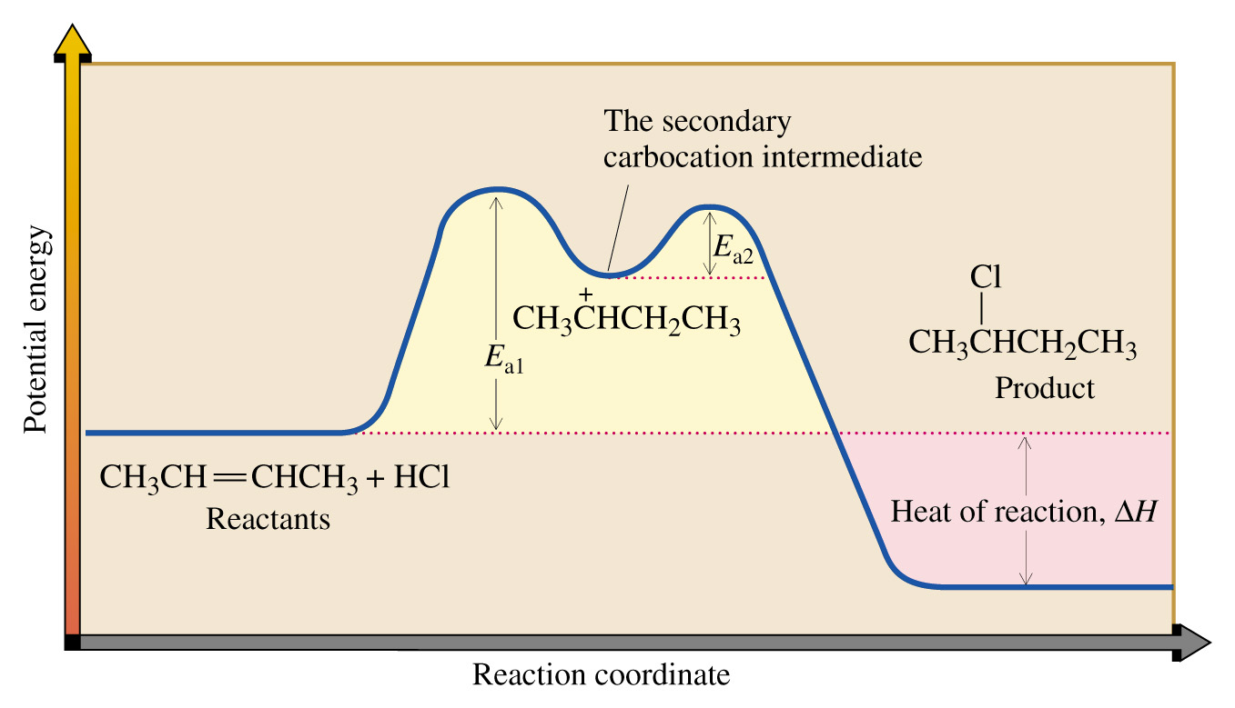

Slide 14
Why is this reaction regioselective?

Slide 15
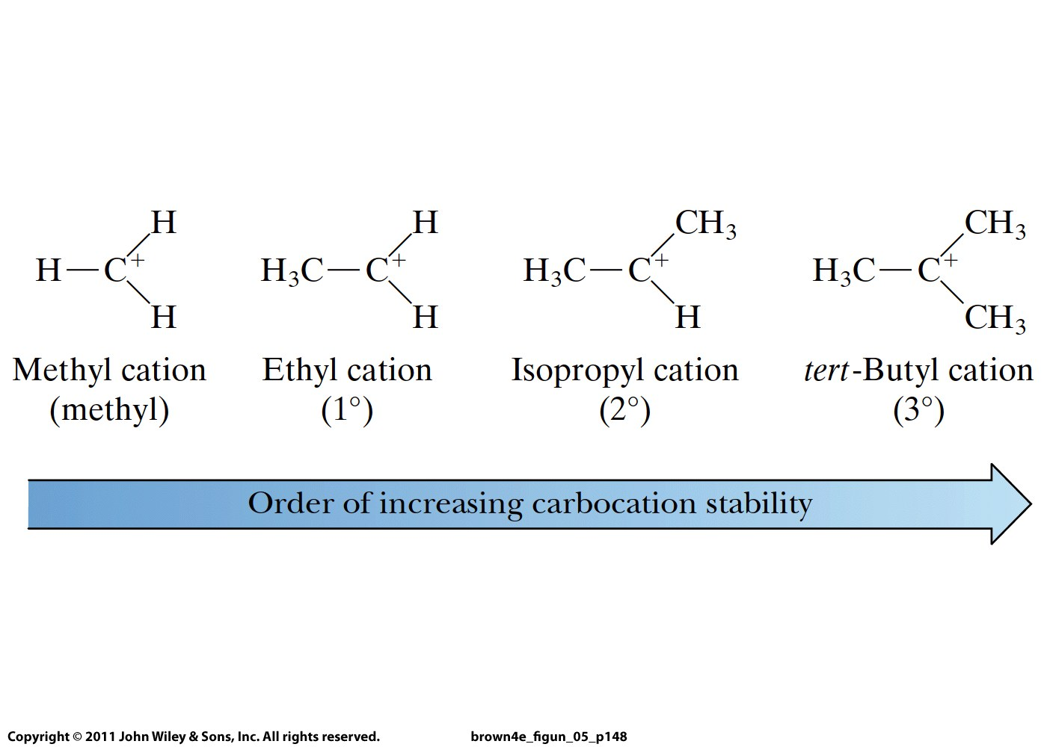

Slide 16
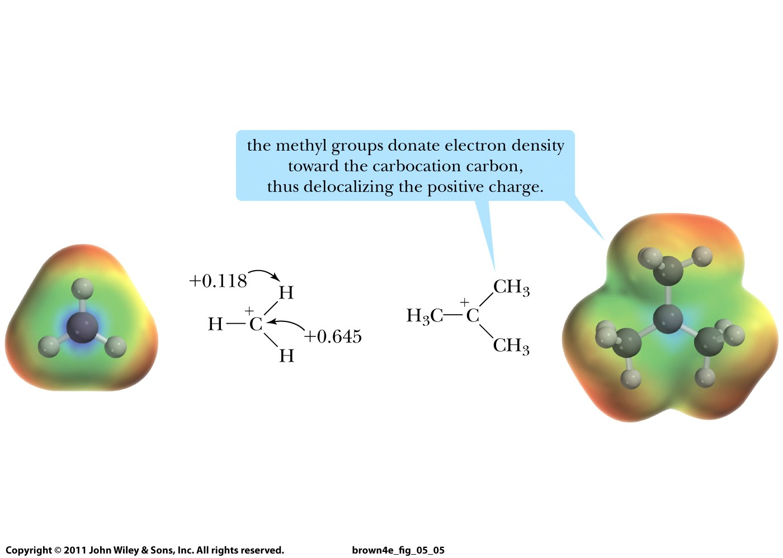
Inductive Effect:

